Slide 1
School Advisory Forums:
Marketing and Getting Participation
Considerations for Your Meeting:
Piggy Back on Another Meeting
PTO/PTA Meeting
SAC Meeting (teachers and administrators must attend even if 0 parents)
SAC has a liaison in your school (usually a teacher) whom you can partner with regarding minutes and announcements
Other locations with likelihood of getting parents to turn out
Sports Field inbetween games (who noted they tried this last year?)
No matter what time you pick, some interested parents won’t be able to attend (during the day, evening)
Make yourself available to hear concerns form those that can not attend
Regardless of when or where, you must have an agenda and minutes (submit to your principal and push for them to be sent out as well as posted on your school website)
How Can You Drum Up Attendance:
You have to explain who we are and what we do (see next slide)
Getting the word out
Publize at other events (PTO, PTA)
Hand out flyers at carline (ask your Assistant Principals to help)
Work with your princpal to get a flyer or notice sent out to the school (see next slide)
FACEBOOK - find a group in your area and post
OTHER THINGS THAT HAVE WORKED?
You do not need a large group
3 dedicated parents can be a huge help

Slide 2
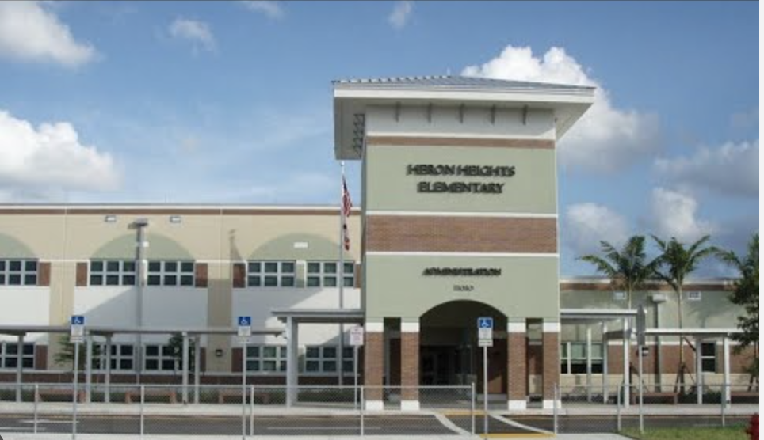
Heron Heights Elementary
SAF
November 2024 Newsletter and Meeting Agenda
Meeting: Monday 11/18/2024 2:30pm
Chair: Michael Pezzicola Vice-Chair: Britt Ehren
cell: 732.773.4318
email: hhesafvicechair@gmail.com
What is SAF?
SAF stands for the School Advisory Forum.
Every school shall have a School Advisory Forum (SAF) that shall foster and promote communication between its stakeholders, the school and the Regional Advisory Council. The SAF shall bring forth recommendations, concerns and interests to and from their Regional Advisory Council. Link to Policy 1.3.
We are forum to raise school level concerns to our administration, as well as bring broader questions or ideas to (or from) the North Area Advisory Council of Broward County.
Future Meetings
December 2, 2024
January 21, 2025 *
February 24, 2025
April 2, 2025
May 1, 2025
Resources and Notes from the Chairs
November Ballot Measure
Broward County Referendum 2
The measure PASSED. This will mean that the Broward County Inspector General will now investigate concerns over Broward policy, process, and budgeting.
More details here:
https://www.browardschools.com/IGamendment2024
School Choice Resources
DAC supported a motion that would have moved school choice deadlines to before the end of the year - meaning, you would have known a decision by 1/1/25 if you applied for a school choice offering for 2026. The board rejected the change, but school choice decisions will still be processed earlier in than the past.
More details to come here:
https://www.browardschools.com/Page/52733
Resources Shared in the Past
Anti-Bullying Policy
Overall policy is Policy5900.
The three elements of bullying are:
R – Repeated (happens more than once)
I – Imbalance of Power
P – Purposeful (intends to harm)
Inclusive Student Guide
The guide can be found online here:
Here
Board of Education Members
You can find emails to board of education members Here
Agenda for 11/18/2024 Meeting:
School Calendar Motion: The DAC recommended via a motion to the Board of Education that school calendars be approved 2 years in advance by the first board meeting in October (meaning that the calendar for 2026-2027 should be approved in the October 2025 board of education meeting).
Middle School Expo: December 10th at 6 PM [Time may change): Pompano Beach High School
For those with older students at HHE, the north region is hosting a middle school expo where all schools will be present on December 10th so you can meet administrators.
A Word of Thanks on Typing: At the last regional meeting, many parents raised concerns for 4th graders not being able to type fast enough for the FAST tests on reading/comprehension. I know that HHE students begin exposure and lessons on typing in earlier years in preparation.
Open floor to any topics raised by parents during or before the meeting
You can text Mike Pezzicola at 732.773.4318 to raise any topics before the meeting

